Slide 1
EVENT MANAGEMENT SYSTEM FOR UNIVERSITY
NAME : NARAYAN JHA
ROLL.NO : 5

Slide 2
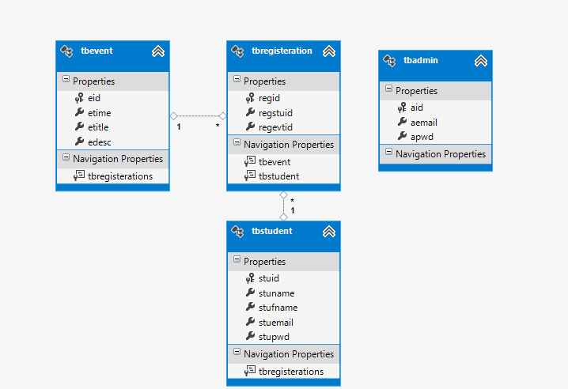
DATABASE ARCHITECTURE

Slide 3
MODULES
Admin Module
Dashboard(Analytics)
Add Events
Registered Students
Fast Scanner
Student Module
Profile(Admit Card With QR Code)
Register Event
Registered Events
Anonymous Module
Event Page
Login
Signup

Slide 4
LIVE SERVER
URL : http://narayanproject.somee.com/
All thanks to somee.com for providing free webhosting.
THANK YOU

